Slide 1
education day 2026 lecture assistant for universal design for learning
Dr. Trevor Thang
DDS, MSc (Oral Radiology), Dip. ABOMR, FRCD(C)

Slide 2
setting the scene
course director for:
  graduate in-person course for all PGY1 resident
the problem
barriers for absent students or those who prefer written vs. audio
slides are an adjunctive tool and are not meant to be comprehensive
the solution
“multiple means of representation” using universal design for learning
locally-hosted AI lecture assistant

Slide 3
what is universal design for learning (UDL)?
course design framework to meet the needs of
people with different backgrounds, abilities, and learning styles.
what is multiple means of representation?
provide content in multiple formats (text vs. audio)
to empower student autonomy in learning
Notes:
Benefits for educators
Such as facilitators, coaches, course instructors, and developers
Inclusive teaching can enhance student learning.
It reduces the workload of arranging individual and specialized accommodations.
It can improve learner engagement, reaching a wider audience, which could lead to better course evaluations.
Benefits for learners
Less time is spent finding individual accommodations and more time focusing on course content.
Greater inclusion of learners from diverse backgrounds and abilities can lead to increased retention and motivation.
Learners are not seen as different, which can help reduce stigma and foster a positive learning environment.

Slide 4
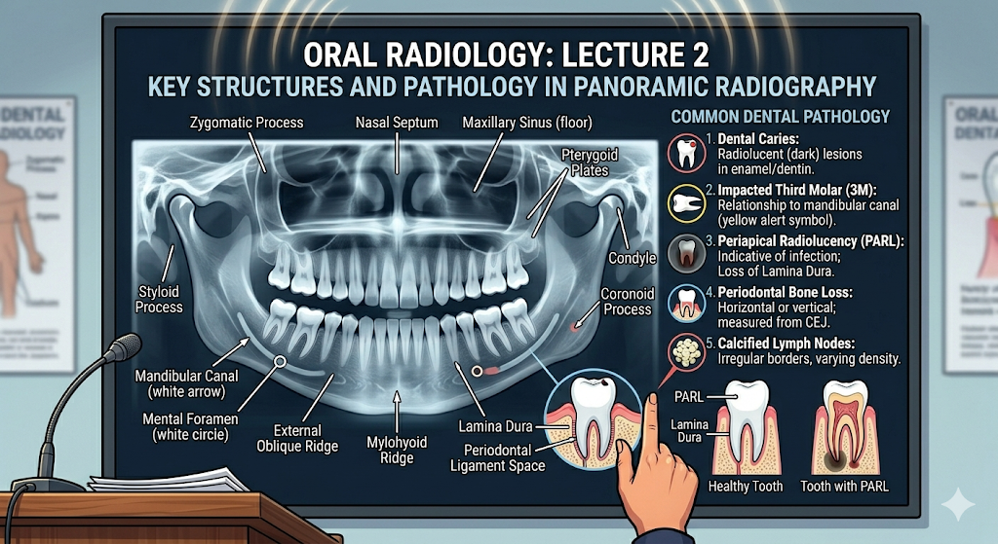

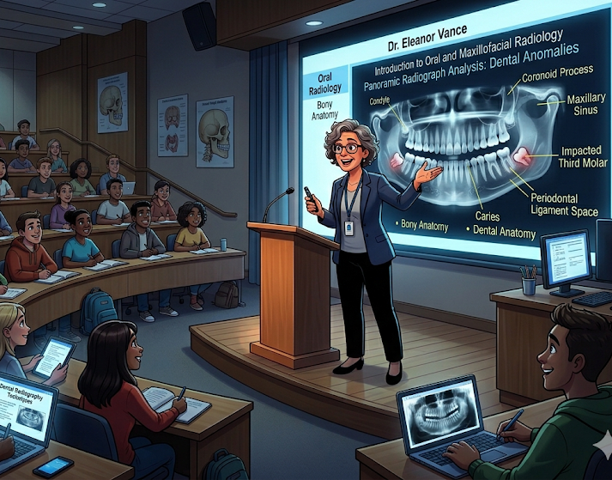
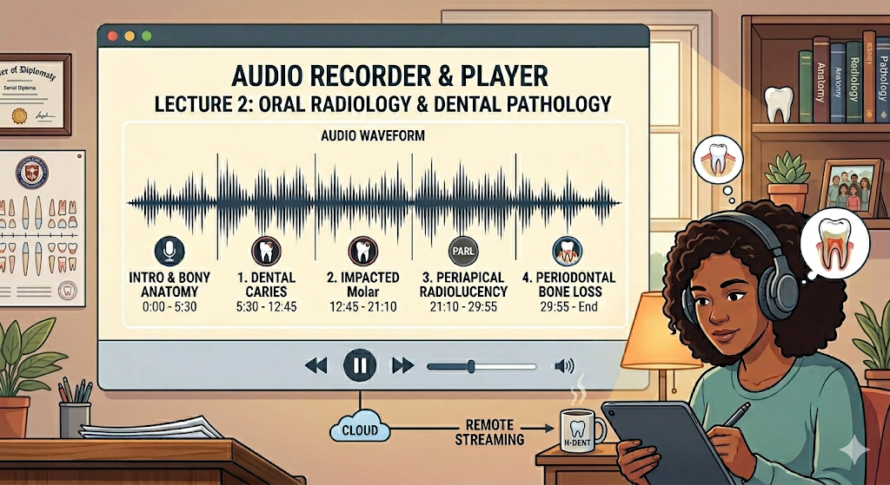

Images and videos were generated with Gemini AI
presentation slides
live voice

Slide 5
Images and videos were generated with Gemini AI
presentation slides
live voice
lecture recordings

Slide 6

Images and videos were generated with Gemini AI
presentation slides
lecture summaries
live voice
lecture recordings

Slide 7
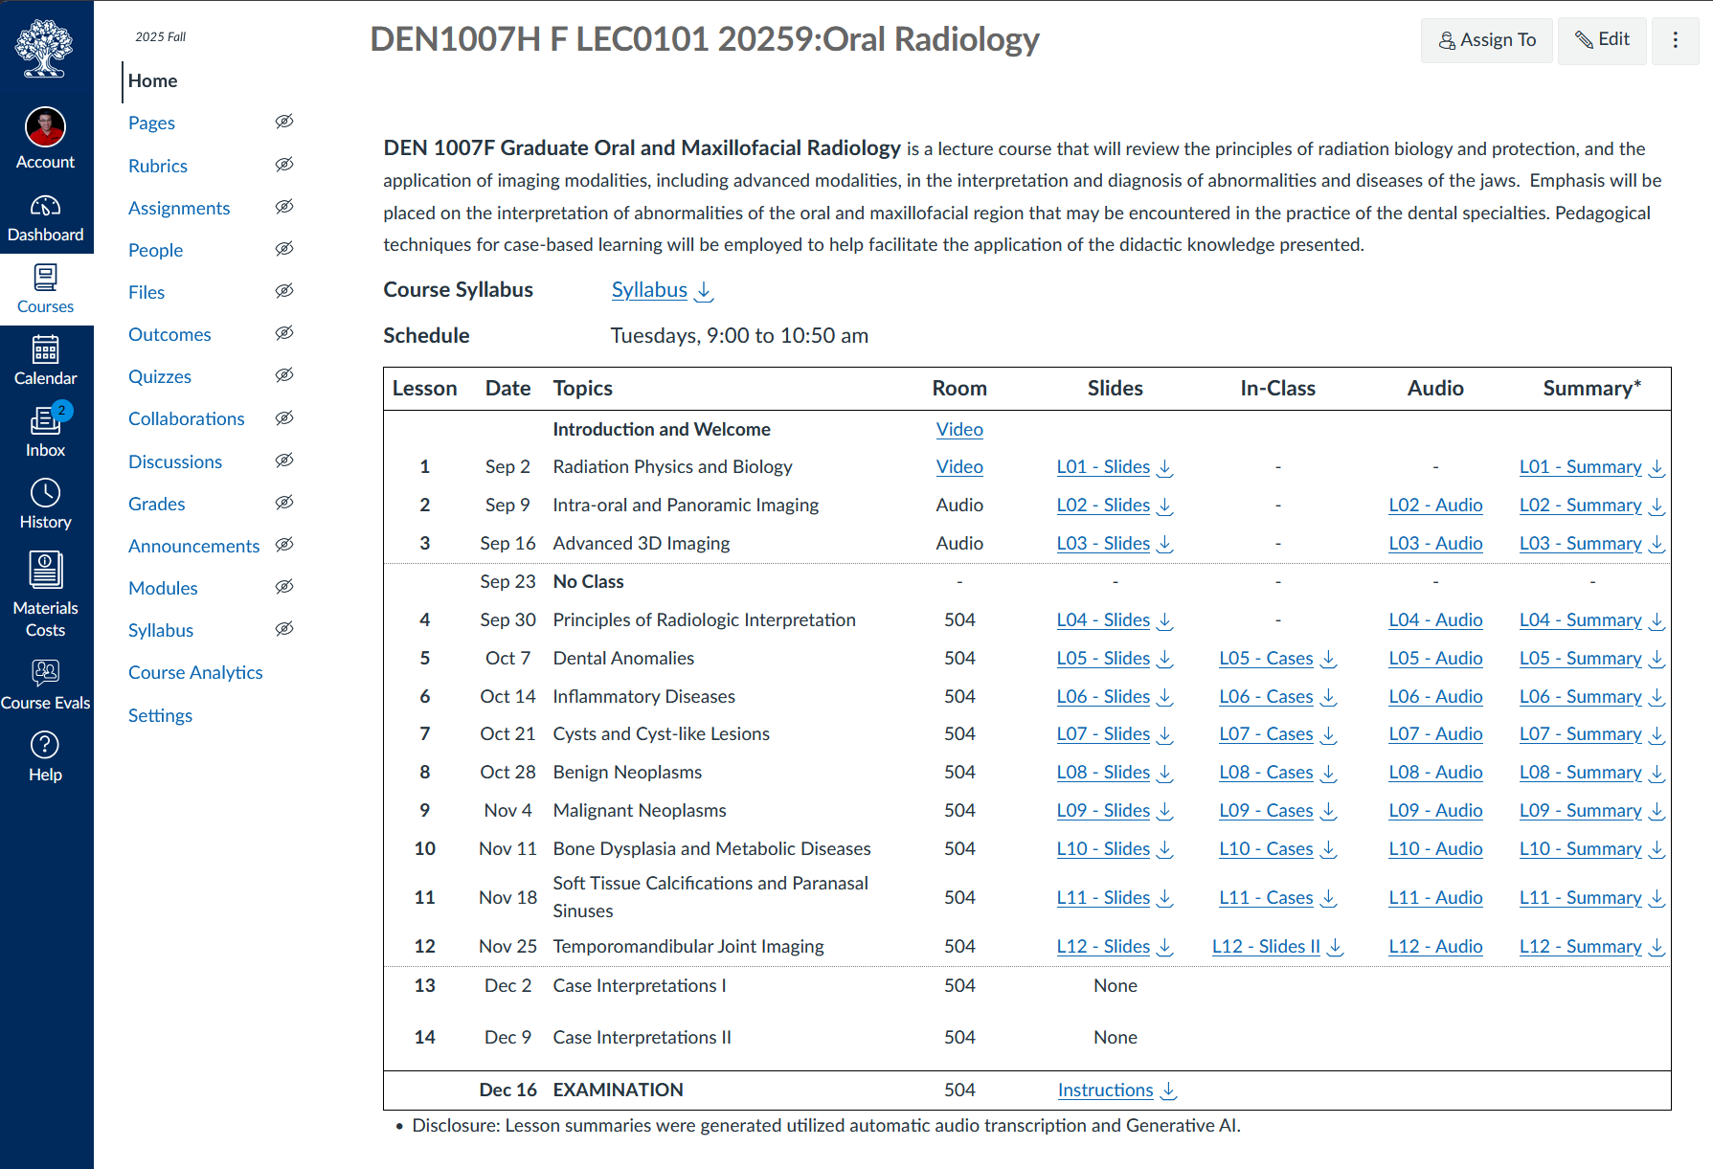

Slide 8
students value these additions

Slide 9
students value these additions
Elaborate on what made these tools effective or ineffective:
I really like that I can listen to the lectures again when I am on the subway going home, I found it very useful to consolidate my learning.
Lecture summaries had more information that was missing in the slides. it helped me put concepts together
[…] Lastly, the lecture summaries helped me summarize the entire concept concisely and helped me remember for the exam. Overall, every resource in this course was tremendously helpful. […]

Slide 11
what are the benefits of this format?
reduces cognitive overload by minimizing digital distractions
sets clear expectations: students don’t worry about ‘missing’ something buried within their digital courses.
improves accessibility by ensuring that all materials are intuitively organized and easy to retrieve.
enhances student engagement by removing logistical barriers

Slide 12
thank you for your attention questions?

